Slide 1
Derivation Of Beer Lambert Law

Slide 2

SUBMITED BY: -
NAME : GORANTLA RAJESH
DEPT : PHARMACEUTICS
CLASS : M PHARM
REG. NO : 23G41S0306
COLLEGE: JNTUA
SUBMITED TO: -
DR M MAHESH SIR. PH.D HOD
Modern Pharmaceutical Analytical Technology
JNTUA

Slide 3
Beer-Lambert Law derivation : It helps us define the relationship between the intensity of visible UV radiation and the exact quantity of substance present. The derivation of Beer-Lambert Law has many applications in modern-day science. Used in modern-day labs for testing of medicines, organic chemistry and tests with quantification
Beer-Lambert Law Statement : A given material sample path length and concentration of the sample are directly proportional to the absorbance of the light.

Slide 4
The Beer-Lambert law is expressed as:
where,
A is the amount of light absorbed for a particular wavelength by the sample
ε is the molar extinction coefficient
L is the distance covered by the light through the solution
c is the concentration of the absorbing species
A = εLc

Slide 5
But Beer-Lambert law is a combination of two different laws: Beer’s law and Lambert law
What Is Beer’s Law?
Beer’s law was stated by August Beer which states that concentration and absorbance are directly proportional to each other.
What Is Lambert Law?
Johann Heinrich Lambert stated Lambert law. It states that absorbance and path length are directly proportional

Slide 6
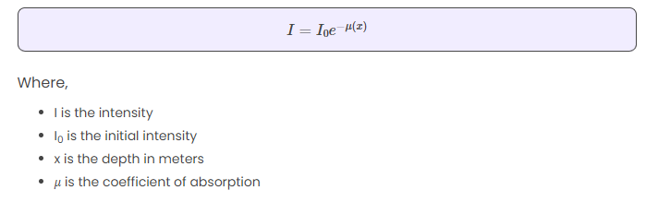
Beer-Lambert Law Formula

Slide 7
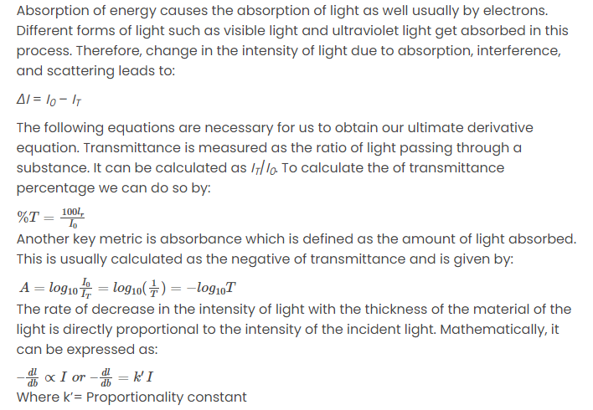

Slide 8
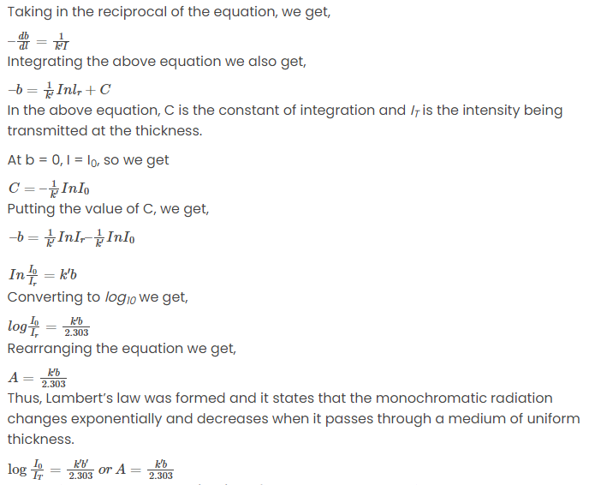

Slide 10
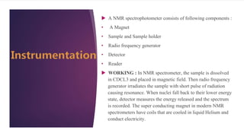

Slide 11
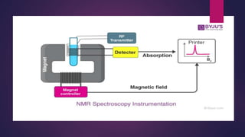

Slide 12
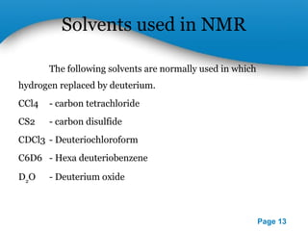

Slide 13


